Slide 1

Squad infotech project
Project Level -1
Presenter - Apeksha Khot

Slide 2

Student Management system
Project Title

Slide 3
Summary
This is Project can be used by college or classes after incorporating some changes.
It is implemented using python where object oriented concepts are extensively used also it contains MySQL database for data storage.
It mainly has 2 sections admin section and student section. In student section student can register, login, submit application and view application status, whereas admin can accept the submitted application, add new student, remove student, view all student and view pending application.
Good programming practices are also followed while developing this application such as version control using git & GitHub, exception handling, well commented code, etc.

Slide 4
Features
Admin section
Add student
Add from pending applications
Add new student
Remove student
List student
View Pending Applications
Student Section
Register student
Login student
Submit application
View application status

Slide 5
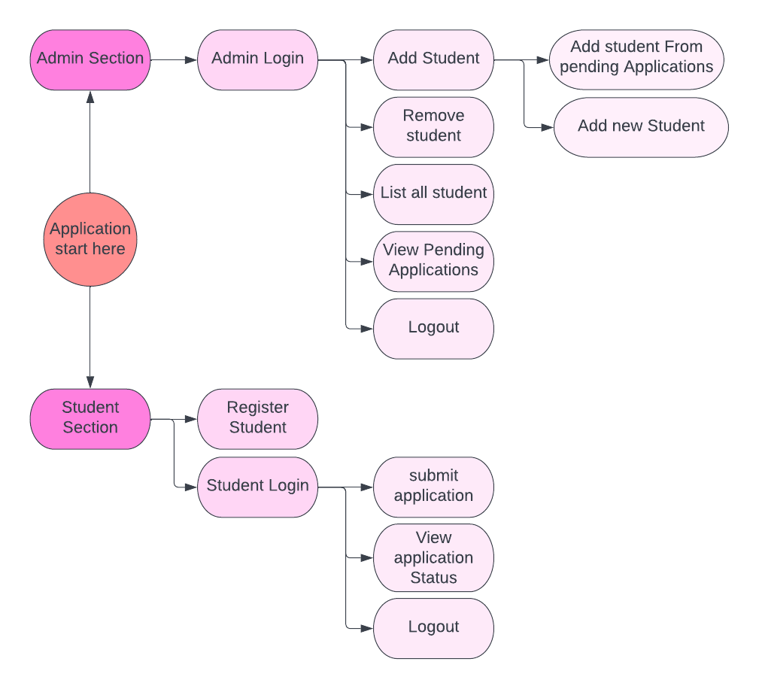
Flow Chart

Slide 6
table

Slide 7
The way to get started is to quit talking and begin doing.
Walt Disney

Slide 8
team

Slide 9
timeline
Title
To start a presentation, go to the Slide Show tab, and select From Beginning.
Title
To display Presenter view, in Slide Show view, on the control bar at the bottom left select the three dots, and then Show Presenter View.
Title
During your presentation, the speaker notes are visible on your monitor, but aren't visible to the audience.
Title
Title
The Notes pane is a box that appears below each slide. Tap it to add notes.
If you don’t see the Notes pane or it is completely minimized, click Notes on the task bar across the bottom of the PowerPoint window.

Slide 10
content
Subtitle
Subtitle
Add text, images, art, and videos.
Add transitions, animations, and motion.
Save to One Drive, to get to your presentations from your computer, tablet, or phone.
Add text, images, art, and videos.
Add transitions, animations, and motion.
Add text, images, art, and videos.
Add transitions, animations, and motion.
Save to One Drive, to get to your presentations from your computer, tablet, or phone.
Add text, images, art, and videos.
Add transitions, animations, and motion.

Slide 11
Content 2
Subtitle
Subtitle
Subtitle
Add text, images, art, and videos.
Add transitions, animations, and motion.
Save to One Drive, to get to your presentations from your computer, tablet, or phone.
Add text, images, art, and videos.
Add transitions, animations, and motion.
Add text, images, art, and videos.
Add transitions, animations, and motion.
Save to One Drive, to get to your presentations from your computer, tablet, or phone.
Add text, images, art, and videos.
Add transitions, animations, and motion.
Add text, images, art, and videos.
Add transitions, animations, and motion.
Save to One Drive, to get to your presentations from your computer, tablet, or phone.
Add text, images, art, and videos.
Add transitions, animations, and motion.

Slide 12
Thank you
Presenter Name
Email Address
Website Address

